Slide 1
GTF - ABSi
Demo – Selenium POC
Date: June, 2019

Slide 2



Objectives
Demo – Selenium POC
  The following subjects will be treated:-
  Basic folder structure of the Framework
  Test Execution Techniques
  Test Execution Flow
  Ease of adding new Test Cases
  Results and Reporting
  Defect Creation in JIRA
  Future Scope & Limitations

Slide 3
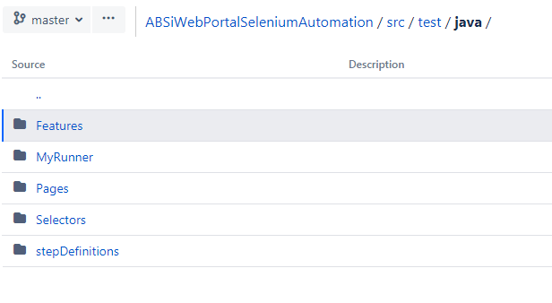
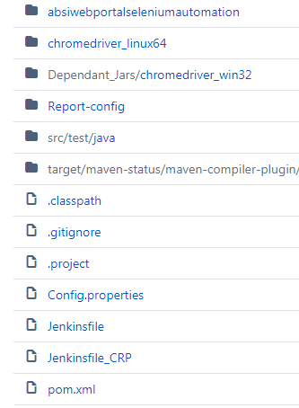
Basic folder structure of the Framework :
The framework contains the following folders depending test resources:
Cucumber Reports – Contains Cucumber HTML report and Screenshots
Dependent Jars –Contains dependent jar files or exe files
Report Config – Contains .xml file for Cucumber report
src/test/java/Features – Contains feature files which are having test script
src/test/java/MyRunner – it is the main test script that gets triggered
src/testjava//Pages – Contains all functions
src/test/java/Selectors – Contains all pages xpath, URL etc.
src/test/java/stepDefinitions – Contains all step definitions which are connected to feature file steps
Pom.xml – contains all dependancies

Slide 4
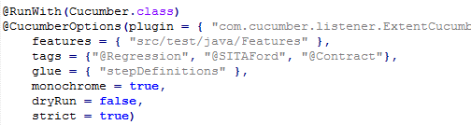
Test Execution Flow
  Add the test scenarios in feature files
  Add the Test Data as per test scenarios in PageElementValues.file
  Add the test suite in TestRunner file with below combination:
  Execute the Test scenario in Web Portal
  At the end of execution CucumberHTML Report can be seen on browser and same will be emailed

Slide 5
Ease of adding new Test Cases
  We have created generic step definitions so we can use those steps repeatedly to reduce our efforts. Whenever need to add scenario then only write scenario and test data
  We have automated below scenarios for the POC:
  Person Search
  Contract Search
  Quick Create Contract
  Create Contract
  Validation for Person search, Contract search and Create Contract

Slide 6
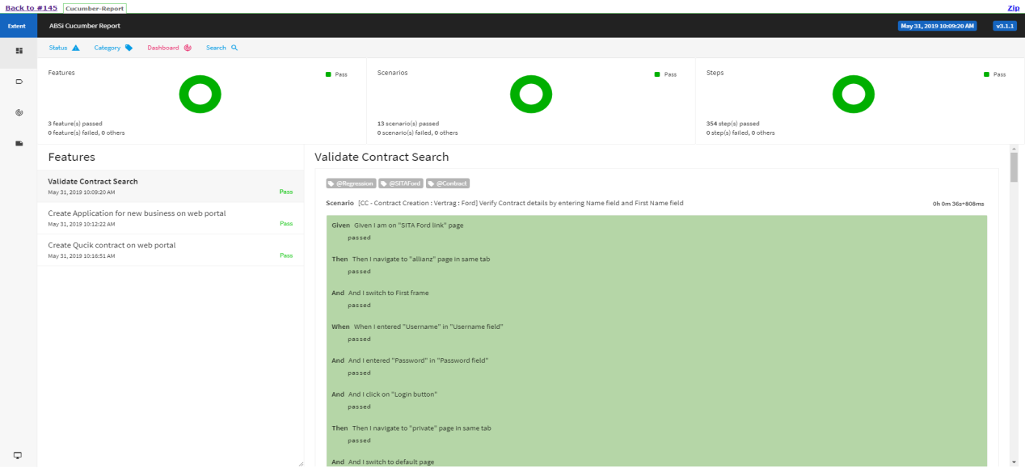
Results and Reporting
Results:
Results can be viewed in HTML Report and Screenshots. Report will be generate with steps, Error Logs(if scenario fails), Screenshot and Defect ID(if scenarios fails and JIRA defect created successfully)
Reports:
Reports are generated in two categories:
HTML – CucumberHtml report with steps, logs, screenshots and JIRA Defect ID
Email – An email with CucumberHTML report link
Sample CucumberHTML Report

Slide 7
Defect Creation in JIRA
  For defect creation in JIRA we have identified the JSON template which can be used to create a new JIRA Defect using REST API.
  We are updating the JSON file every time when a Test scenario fails and it is saved in the required location.
  Now we post the JSON using REST API by triggering JiraRestClient.java
  5. JIRA related jars updated in pom.xml for Maven project

Slide 8
Future Scope & Limitations
Currently parallel execution is managed from Maven project.
In future, parallel execution will do in Jenkins.

Slide 9


Thank You!!
Questions and answers??

Slide 10
GTF - ABSi
Demo – UFT POC
Date: June, 2019

Slide 11
Objectives
Demo – UFT POC
  The following subjects will be treated:-
  Basic folder structure of the Framework
  Test Execution Techniques
  Test Execution Flow
  Ease of adding new Test Cases
  Results and Reporting
  Defect Creation in JIRA
  Future Scope & Limitations

Slide 12
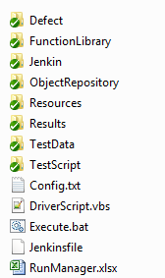
Basic folder structure of the Framework :
The framework contains the following folders depending test resources:
Defect – Contains jars & JSON for creating defect
Function Library – Contains F/W and application related functions
Jenkin – Contains Jenkins file for Test Execution
Object Repository – Contains shared object repository
Resources – Contains logo and unique id table
Results – Contains reports – Excel, HTML, Logs, Screenshots
Test Data - Contains Data sheet related to each Product Area
Test Script – it is the main test script that gets triggered
Config.txt – to give initial settings to the frame work
DriverScript.vbs – to trigger test script
RunManager.xlsx – the tests that needs to be executed

Slide 13
Test Execution Flow
  Add the Test Scenarios and TC in RunManager.xlsx
  Mark the TCs to be executed as ‘Y’
  Add Test Data for TC in Product Area - Scenario Wise Test Data sheet
  Execute the Test Cases in UFT TestScript
  Test is Run in Rich Client and Host Access Applications
  At the end of execution HTML Result can be seen on browser and same will be emailed

Slide 14
Ease of adding new Test Cases
  We have created Test Cases based on Test Scenarios which will help us in reducing redundancy of code in Function Library, as flow remains the same we will need to change the Test Data. All the validation points will be considered in the flow:
  We have automated below scenarios for the POC:
  Person Search & Create
  Contract Search & Create
  Claim Creation With/Without Contract
  Contract Modification G08
  Contract Modification G80 on Begin Date

Slide 15

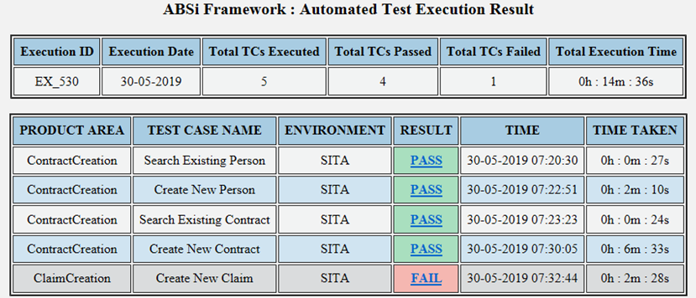
Results and Reporting
Results:
Results can be viewed in Excel, HTML, Screenshots and Execution logs. The folder structure consists of Date Wise > Execution Wise > Run Id and TC name
Eg: \Results\HTMLResult\10052019\EX_376
Reports:
Reports are generated in two categories:
HTML – a summary of TCs run in current execution, with links to the detailed execution report along with the screenshots also gets opened on browser.
Email – An email with HTML body text containing the summary of the TCs executed
Sample Result Summary

Slide 16



Defect Creation in JIRA
  For defect creation in JIRA we have identified the JSON template which can be used to create a new JIRA Defect using REST API.
  We are updating the JSON file every time when a Test case fails and it is saved in the required location.
  Now we post the JSON using REST API by triggering JiraUtilityBatch.bat
  The JIRABatch folder contains all the defect related resources(JSON file, REST API jar, config file and other related jars)
  5. The folder set up looks like below:
CodeUtility
resources

Slide 17
Future Scope & Limitations
Need to implement the detailed report in single Execution Result in mail.
Jenkins implementation for parallel execution is in Progress

Slide 18
Thank You!!
Questions and answers??

